Slide 1
PRIYADHARSHINI V
821721243043
BTECH., ARTIFICIAL INTELLIGENCE AND DATA SCIENCE – III YR
SIR ISSAC NEWTON COLLEGE OF ENGINEERING AND TECHNOLOGY

Slide 2
PROJECT TITLE
HAND WRITTEN DIGIT RECOGNITION(USING CNN)

Slide 3


AGENDA
The agenda of Hand Written Digit Recognition using Convolutional Neural Networks (CNNs) involves the use of deep learning techniques to classify images of handwritten digits into their corresponding numerical representations (0-9). CNNs extract meaningful features from raw pixel data through convolutional layers, enabling hierarchical learning of patterns. This project includes several key tasks:
- Data Collection
- Data Preprocessing.
- Model Training and model Design.
- Hyperparameter Tuning and Optimization.
- Documentation and Reporting
The ultimate goal of handwritten digit recognition using Convolutional Neural Networks (CNNs) is to accurately and efficiently recognize and classify handwritten digits in images. This task has several broader objectives and potential applications

Slide 4

PROBLEM STATEMENT
The task of handwritten digit recognition using Convolutional Neural Networks (CNNs) aims to develop a robust and accurate system capable of automatically identifying and classifying handwritten digits from input images.
By addressing these aspects, the project aims to develop a reliable and versatile solution for handwritten digit recognition using CNNs, with potential applications in fields such as digitized document processing, optical character recognition (OCR), and educational technology.

Slide 5

PROJECT OVERVIEW
The project involves implementing Convolutional Neural Networks (CNN) for Hand Written Digit Recognition tasks. Handwritten digit recognition is a fundamental problem in the field of computer vision and machine learning. This project focuses on developing a Convolutional Neural Network (CNN) model to accurately classify handwritten digits (0-9) from images.
Leveraging the power of deep learning, the goal is to create a robust system capable of recognizing digits with high accuracy, even in the presence of variability in writing styles and noise.
The primary objective of this project is to design, train, and evaluate a CNN-based model for handwritten digit recognition. The model will be trained on a dataset of labeled digit images and optimized to achieve high accuracy in classifying unseen digits.

Slide 6
WHO ARE THE END USERS?
The end users of Handwritten Digit Recognition using Convolutional Neural Networks (CNNs) can vary depending on the specific application and context. Here are some potential end users for such a system:
Researchers and Developers
Educators and Students
Businesses and Enterprises
Financial Institutions
Postal and Logistics Services
Accessibility and Assistive Technology Users
Technology Enthusiasts and Hobbyists
Overall, the end users of Handwritten Digit Recognition using CNNs span
wide range of domains and industries, reflecting the diverse applications
and potential impact of these systems in various contexts.
.

Slide 7

YOUR SOLUTION AND ITS VALUE PROPOSITION
This Project solution to Handwritten Digit Recognition using Convolutional Neural Networks (CNNs) involves developing a robust and accurate system capable of automatically identifying and classifying handwritten digits from input images. This solution utilizes deep learning techniques, specifically CNN architectures, to effectively extract features from digit images and make accurate predictions
The CNN model achieves high accuracy in classifying handwritten digits, even in the presence of variability in writing styles and noise he CNN model achieves high accuracy in classifying handwritten digits, even in the presence of variability in writing styles and noise.

Slide 8

THE WOW IN YOUR SOLUTION
Convolutional neural network (CNN, or ConvNet) can be used to predict Handwritten Digits reasonably. We have successfully developed Handwritten digit recognition with Python, Tensorflow, and Machine Learning libraries. Handwritten Digits have been recognized by more than 98.9% validation accuracy.
Character recognition algorithms are classified into three categories. These categories are often employed in sequence: pre-processing, feature extraction, and classification. The pre-processing aids in the smoothness of feature extraction, while feature extraction is required for successful classification.
3/21/2024 Annual Review
8

Slide 9
MODELLING
In handwritten recognition digits, characters are given as input. The model can be recognized by the system. A simple artificial neural network (ANN) has an input layer, an output layer and some hidden layers between the input and output layer. CNN has a very similar architecture as ANN.
We describe a method of recognizing handwritten digits by fitting generative models that are built from deformable B-splines with Gaussian "ink generators" spaced along the length of the spline.
In Handwritten Character Recognition (HCR) the task is to identify the characters written by humans and converting it into digital text. HCR is a field where plenty of research has been done but still there is scope in terms of improving the accuracy and efficiency.
9

Slide 10
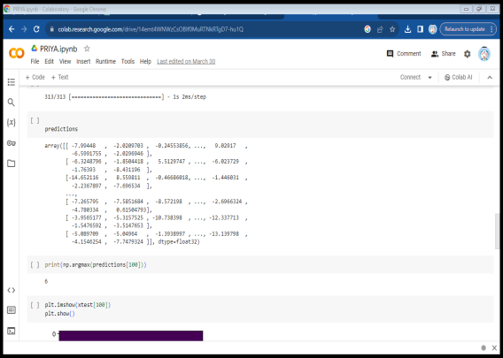
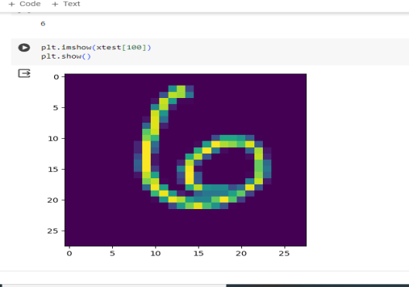
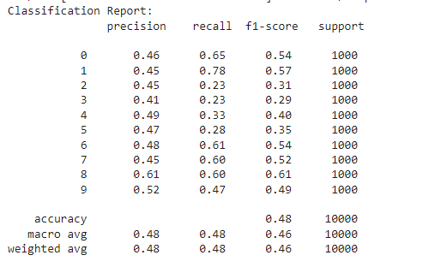
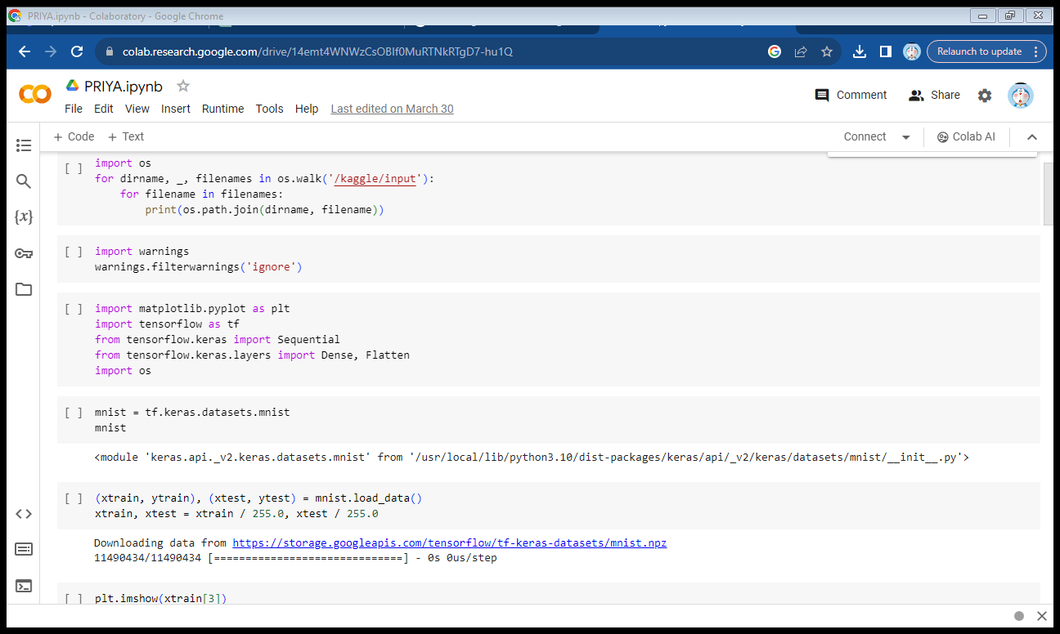
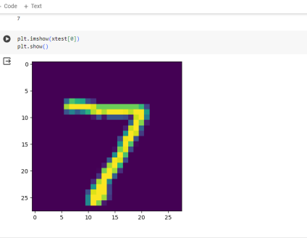
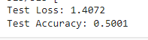
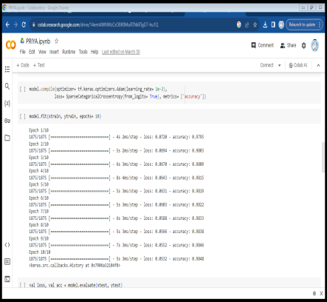
RESULTS
Predictions
Test outputs
Training model
Test loss and test accuracy
Testing the model
10

